Slide 1

School Of Computer Science and Engineering
CLOUD FORENSICS WITH KUBERNETES
Guided By: Dr. Narayan D.G
Team Members:
Name | Roll No | USN
Neha Chandavari | 308 | 01fe21bcs075
Rutuja Chikkorde | 318 | 01fe21bcs175
Prajwal Mutnal | 529 | 01fe21bcs159
Nirmala Kanti | 534 | 01fe21bcs180

Slide 2
Introduction:
Blockchain technology in simple words is a digital database where information or data is stored in blocks that are linked together to form a chain.
A digital ledger of transactions that is secure, immutable, and decentralized.
Transactions are verified by a network of computers. Once a block of information is created in the chain, it can’t be changed or deleted. This makes the blockchain very secure and trustworthy. It is a software protocol, it never runs without the internet.

Slide 3
Objectives:
Improving security for cloud storage system and preventing malicious attacks from unauthorized users.​
Cloud Forensics ensures the preservation of evidence integrity, authenticity, and privacy while meeting legal and regulatory requirements, making it a valuable tool for organizations facing cloud-related security incidents and investigations. ​
Retrieving the log files from CSP and maintaining a secure and separate applications or database for storing logs and adding hash values to the blockchain.​
Extracting information from large log files .​
Reducing the dependency on CSP​

Slide 4
Motivation:
This blockchain-based cloud forensics solution offers a secure, transparent, and auditable method for handling digital evidence in cloud environments.​
It ensures the preservation of evidence integrity, authenticity, and privacy while meeting legal and regulatory requirements, making it a valuable tool for organizations facing cloud-related security incidents and investigations.
We retrieve pod logs from Kubernetes and secure them using blockchain technology.

Slide 5
Literature Survey

Slide 6
Forensic-Chain : Ethereum Blockchain Based Digital Forensic Chain of Custody
Forensic-Chain utilizes blockchain, a distributed and immutable ledger, to record and securely store transactions (events/records) related to digital evidence.
Smart contracts, self-executing contracts with coded terms, automate the recording of actions related to the evidence. They automatically log details such as access time, date, user ID, and other critical information.​
Along with evidence hashes, details like the location, time, and date of the crime scene are recorded on the blockchain.
Encrypted evidence data ensures only authorized parties can access it. The blockchain records access information without compromising the security or privacy of the actual evidence​.
The future work aims at developing complete Ethereum based smart digital forensic chain of custody using smart contracts.

Slide 7
Data Provenance Assurance for Cloud Storage using Blockchain
A. Storage Application-Use Amazon Web Services (AWS) SDK to develop storage applications. We used Boto3 model of AWS SDK for Python. Before using Boto3, we set up authentication credentials, and generate a new set of keys, and we accessed boto3 SDK and uploaded the files in the Simple Storage Service (S3).
B. Data Provenance Assurance- When the user performs any operations on any file, it triggers to generate metadata, which is anchored to the Blockchain network and IPFS.
Data Storage Provenance Algorithms- Algorithm 1: Retrieval of Metadata- When the user performs any operations on any files, the log is added to IPFS and subsequently to the Blockchain. Output is metadata log is generated
Algorithm 3:Storing in Blockchain and IPFS & Validation if any discrepancy- Provenance Validator gets block id and checks the hashed metadata from the Blockchain with the metadata from the IPFS. If the values corresponding to all the rows match, if the returned value is true, then the data has not tampered; if the returned value is false, then the data has tampered.

Slide 8
A Blockchain-based Log Storage Model With Efficient Query
This paper focuses on the file logs
They implemented the log storage schema based on the blockchain and interplanetary file system(IPFS)
To achieve faster query response, they improved the Merkle tree methods, including baseline and enhanced methods.
These methods find the data by log timestamp
To obtain query results, they utilized the Timestamp Point Query Algorithm and the Timestamp Range Query Algorithm.
Solution is compared with the Merkle tree of Yue's schema which constructs some multi-branched Merkle trees based on data shards.
Incorporating advanced techniques such as machine learning and natural language processing to enhance the accuracy and efficiency of the log data analysis and anomaly detection.

Slide 9
A Blockchain-Enabled Scalable Network Log Management System
Publication of Log Records-At first, a participating node uploads a file to the IPFS network and receives the corresponding CID. It then immediately constructs the file metadata object and publishes it to BC. The BC network contains an entry for the BC node address, the CID and metadata to link with the corresponding log file in the IPFS network.
Syslog is used as FILE here
Participating nodes retrieve log data from IPFS network using a web interface Audit Log Files In the proposed scheme, auditor nodes serve this purpose. They can access both the IPFS private network and the BC network.
The auditor queries the BC using the timestamp range query to retrieve the CIDS of the log files and then fetches original logs from the IPFS network.
Here, several auditors work concurrently to decide the validity of log files.

Slide 10
BCALS: Blockchain‐based secure log management system for cloud computing
Here, they have used authentication logs
Logs are parsed and stored in multichain streams having uniquely identifiable stream keys for immutability
Logs are transformed into JSON documents and stored in Elasticsearch to find semantics among the user activities.
After parsing log entries into the respective structure, JSON documents are prepared using the given structure so that it can be further published to Blockchain and Elasticsearch. Administrative logs are published to Blockchain and Elasticsearch both, whereas all other types of logs are published to Elasticsearch only.
After parsing the log entries with respect to the given structure, these entries are enriched with semantics by tagging respective information.
JSON documents are created to store in the Blockchain and further to the Elasticsearch.

Slide 11
Leveraging blockchain for immutable logging and querying across multiple sites
The access log data stored on blockchains by using additional key-value stores.
This paper specifically reports on the approach designed for the blockchain track of iDASH Privacy & Security .
Multichain duplicates and indexes blockchain data locally at each node in a key-value store to support retrieval requests at a later point.
To efficiently leverage the key-value storage mechanism, we applied various techniques and optimizations, such as bucketization, simple data duplication and batch loading by accounting for the required query types of the competition and the interface provided by Multichain.
Particularly, implemented solution and compared its loading and query-response performance with SQLite, a commonly used relational database, using the data provided by the iDASH 2018 organizers

Slide 12
Secure Log Storage Using Blockchain and Cloud Infrastructure
In this Paper Centralized log management using cloud helps the organization to auto-scale the infrastructure based on their need.
In the literature review they have mentioned different steps to store securely like storing the log in cryptographic secure manner and algorithm necessary for uploading the log data to the cloud.
Log Verification and validation Algorithm is used using checkpoint hash.
In the paper not only gives a safe log storage platform for long time but also gives the capability for in-depth analysis of archived log record to better understand the complex attack pattern.
Log management system Log Generator devices,Local Log server,Log Monitoring Client, Logging Cloud Server.

Slide 13
SecLaaS: Secure Logging-as-a-Service for Cloud Forensics​
In this paper it introduce Secure-Logging-as-a-Service (SecLaaS), which stores virtual machines logs and provides access to forensic investigators ensuring the confidentiality of the cloud users.
Used Openstack and Snort for testing and implementation .
In the virtualized environment, the Cloud Controller required network adapter configuration in VirtualBox.​
Used RSA (2048 bit) for signature generation and SHA2(SHA-256) hash function for hashing​
Set up Snort in node controller to track the network activity of the virtual machines
By reverse engineering Openstack’s “nova” mysql database, it is also possible to find out the static private IP and user information from a public IP.​
The Proof of Past Log PPL scheme of the SecLaaS is implemented using two accumulators. One is BloomFilter and another is One-Way Accumulator​

Slide 14
An Integrated Framework Implementation For Cloud Forensics Investigation Using Logging Tool
This study focuses on the web log data.
This study primarily focuses on securing the cloud storage system, including checking data integrity and digital forensics, as well as Spark-based large log data analysis.
In this study, they propose a framework to analyze online material in the cloud, focusing on secure data integrity. This involves the extraction of metadata and creating hash data before sharing it with the cloud.
Data integrity is verified by MD5 hash algorithm and metadata matching algorithms.
they propose using the Apache Spark engine to analyze large log data, particularly suited for web server log data in batch and real-time.
This study presents two algorithms for Spark-based log data analysis in batch processing mode: "hits by hour of the day" and "hits by IP address."
Extending the proposed framework to support other types of cloud services and log files, such as network logs, database logs, and application logs.

Slide 15
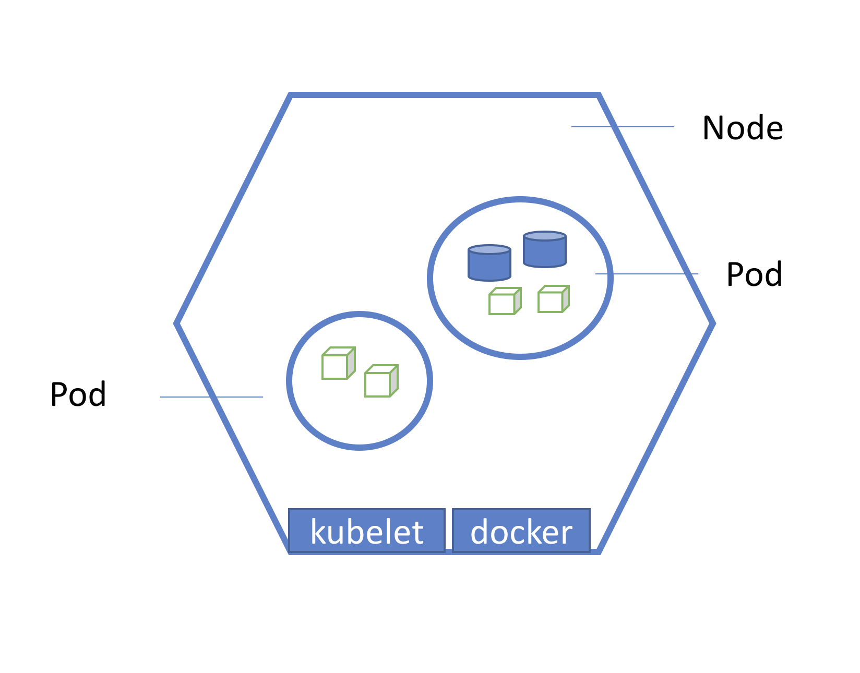





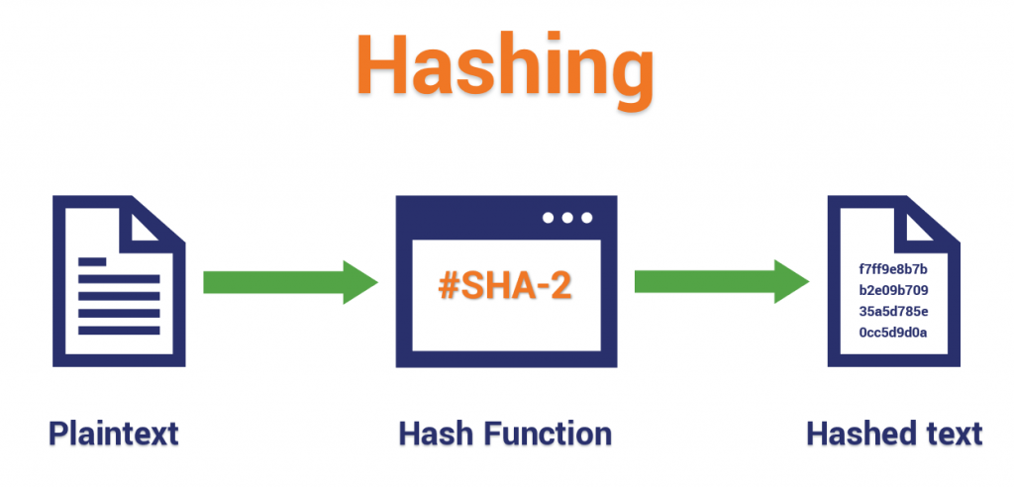
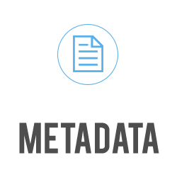



System Model:
1.Retrieve logs from pods of Kubernetes
2.Log Collection with Filebeat
3.Configure Logstash to receive logs from Filebeat
4.IPFS to store the log files
Attacker makes any malicious
6.For investigation, forensics retrieve logs stored in blockchain
Cloud Forensic
5.Log metadata along with its hash added to blockchain

